Slide 1
PRESENTING
CASE STUDY OF PROPOSED SYSTEM
BY GROUP NO.2
PRESENTING
TO
B.P.C.C.S
GANDHINAGAR
SR_NO. | ENROLLMENT_ NO | NAME | ROLL_NO
1 | 21BCA04024 | BHATT KISHAN RAJESHBHAI | 21F002
2 | 21BCA04182 | PARMAR PRATHAMKUMAR | 21F028
3 | 21BCA04348 | PATELVISHABEN PRANBHAI | 21F050
4 | 21BCA04349 | PATEL VISHW BHAVESHKUMAR | 21F051
5 | 21BCA04372 | PRAJAPATI KULDIP BHARATBHAI | 21F053

Slide 2


INDEX
SR NO. | TOPIC
1 | Introduction
2 | Aim
3 | Name Logo Tagline
4 | Entities (Users -All)
5 | Algorithm of each Entities
6 | System Flowchart
7 | Layout
8 | Data flow diagram
9 | E-r diagram
10 | Data dictionary
11 | REGISTRATION AND LOGIN FORM WITH CODING

Slide 3


Slide 4
INTRODUCTION
This presentation is based on project of online ticketing booking system
Website is based on the concept of booking movie tickets.
Talking about the features of this Simple system, the user can book movie tickets.
The user can easily be able to know about the movies released and then make their choice.

Slide 5
AIM
Provide theatre owners and show organizers a platform to connect with customer while hosting their show.
This platform provides user in order for buying / purchasing show and tickets.
This platform provides user to all information.

Slide 6

NAME OF SYSTEM : “CINEWINDOW”
TAGLINE : “EVERY TICKET HAS,
A DIFFERENT JOURNEY”
LOGO :

Slide 7
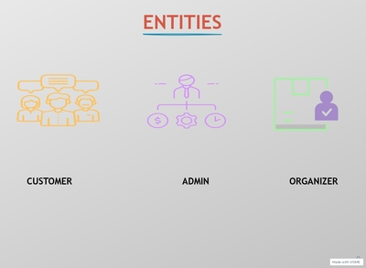

Slide 8
ROLE OF USER
User insert Mobile Number or Gmail id for registration.
User insert O.T.P which generated on inserted mobile number/Mail Id.
User sign up successfully.
User insert user id and password for login.
User can click on forgot password to create a new password.
User insert registered username or mobile number.
Now user insert new password for id.
Now user is registered.
User can search movie/theater as per choice.
User can use filter on search bar like select city, theater type.

Slide 9
User select movie from selected theater page’s movie list.
User select movie show time and movie type like 3D, languages.
After that user select seats from Seating layout.
User click on payment button after getting the invoice.
User can Select multiple payment options – UPI,CARD,NET BANKING.
User should insert UPI ID , if payment method through UPI is selected.
User should insert Card No, Card expire date, if payment method through card is selected.
User should select bank name from list of banks, if payment method through Net Banking is selected..
Now, user will get E-Ticket of show contains all the details of the show.
User can also cancel the show using cancellation process, as per T&C of Theaters.
User can watch trailers of upcoming movies and screening movies on the trailer’s page.

Slide 10
User can get all user details on profile page.
User can get list of services on profile page.
Account provide all details of user ID – User Name, City, Phone Number, Gmail ID and can change the password.
User can change the User ID details from profile page.
History area contains all the history of user booked shows previously.
Can also Register Theater in system, in profile section.
User can add an upcoming movie to the wish list using add button provided on trailer’s page.
User can also get help & support services in profile section.

Slide 11
ROLE OF ADMIN
Admin login in the system using admin id and password.
Admin can search registered theater using search tool which he/she want to find.
Admin can see the registered theaters in admin’s home screen.
Admin can verify the new theater registration request in request box.
Admin contact with theater owners by call and verify it.
Admin can approve registration request of theater owner.
Admin will add an approved theater’s details in system.
Admin can also list theater by own.
Admin will get payment from theatre owner as per deal.
Admin can also remove the theater which is registered previously .

Slide 12
ROLE OF THEATRE OWNER
THEATRE OWNER click on “Register Theater” option in profile page.
THEATRE OWNER gets registration form to send registration request to the admin.
THEATRE OWNER will fill up the details of registration form and submit the form after filling the details.
THEATRE OWNER need to provide all the information of theater to admin in verification call.
Now ,THEATRE OWNER needs enter theater id and password in login page in THEATRE OWNER login page.
THEATRE OWNER will get all information of movie screening in theater and can insert upcoming movies trailers on home page.
THEATRE OWNER can add new movie using add movie.

Slide 13
After that THEATRE OWNER can open movie page from home page.
THEATRE OWNER can add show timing in different screen.
THEATRE OWNER add show times.
THEATRE OWNER can remove movie from system.
THEATRE OWNER can add new screen of movie.
THEATRE OWNER can add upcoming film trailers in trailers list .
THEATRE OWNER can change password from profile page.
THEATRE OWNER gets all history of movies added in system.
THEATRE OWNER can add screens.
THEATRE OWNER will get help & support service for problem solving.
THEATRE OWNER will get all payments on registered bank account from admin.

Slide 14
ALOGRITHM OF USER
STEP 1:- START.
STEP 2:- LOGIN – USER_ID & PASSWORD.
STEP 2.1:- RESET PASSWORD.
OR
STEP 2:-SIGN UP USING PHONE NUMBER/ GMAIL.
STEP 3:- FILL UP REGISTRATION FORM.
STEP 4:-SEARCH MOVIE / THEATER.
STEP 5:- SELECT THEATER FOR SELECTED MOVIE.
OR
STEP 5:- SELECT MOVIE FROM SELECTED THEATER

Slide 15
STEP 6:- SELECT SCREEN, SHOW TIME AND SEATS.
STEP 7:- CHECK INVOICE DETAILS.
STEP 8:- SELECT PAYMENT METHOD AND PAY.
STEP 9:- GET E-TICKET.
STEP 10:- CLICK ON CANCELLECTION TO CANCEL MOVIE TICKETS.
OR
STEP 10:- COME BACK ON HOME PAGE.
STEP 11:- STOP.

Slide 16
ALGORITHM OF ADMIN
STEP 1: - START.
STEP 2: - LOGIN USING ADMIN_ID & PASSWORD.
STEP 3: - VERIFY REGISTRATION FORM.
STEP 4: - CONTACT WITH THEATERS OWNER.
STEP 5: - APPROVE THEATER REQUESTS. OR
STEP 5: - REJECT THEATER REQUEST.
STEP 6: - CLICK ON ADD THEATER.
STEP 7: - FILL UP ALL THEATER DETAILS.
STEP 8: - CALCULATE PROFIT SHARE FROM THEATRE OWNER MONTHLY PROFIT.
STEP 9: - REMOVE THEATER.
STEP 10: - STOP

Slide 17
ALGORITHM OF THEATRE OWNER
STEP 1: START.
STEP 2: LOGIN USING THEATER ID AND PASSWORD.
OR
STEP 2: OPEN WEBSITE, CLICK ON REGISTRATION.
STEP 2.1: FILL UP REGISTRATION FORM DETAILS.
STEP 2.2: GETTING CALL FROM ADMIN.
STEP 3: ADD TRAILERS IN TRAILERS LIST.
STEP 4: CLICK, ADD PAGE TO INSERT NEW MOVIE.

Slide 18
STEP 5: FILL UP ALL MOVIE DETAILS AND SCREEN DETAILS.
STEP 6: OPEN MOVIE PAGE FROM MOVIE LIST.
STEP 7: INSERT SHOW TIME IN DIFFERENT SCREENS.
STEP 8: REMOVE MOVIE.
STEP 9: CLICK PROFILE, SELECT SCREENS.
STEP 10: ADD SCREEN DETAILS & DESIGN SEATS LAYOUT.
STEP 11: STOP.

Slide 19
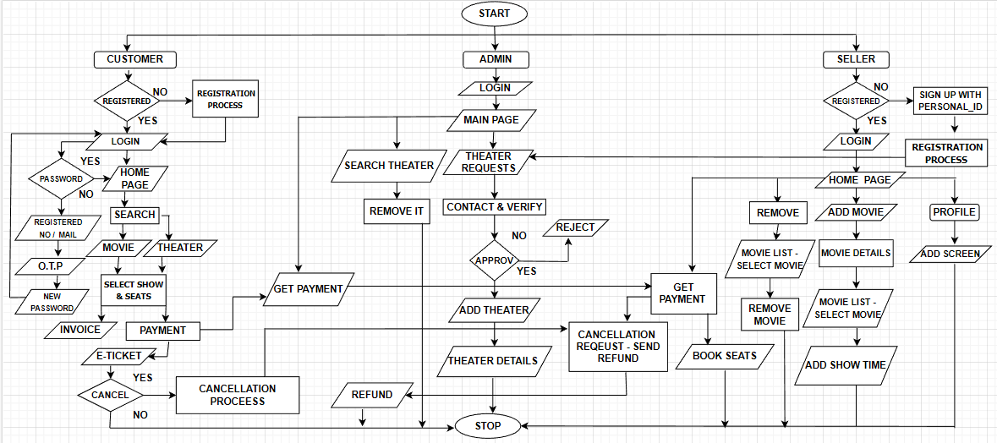
FLOWCHART

Slide 20
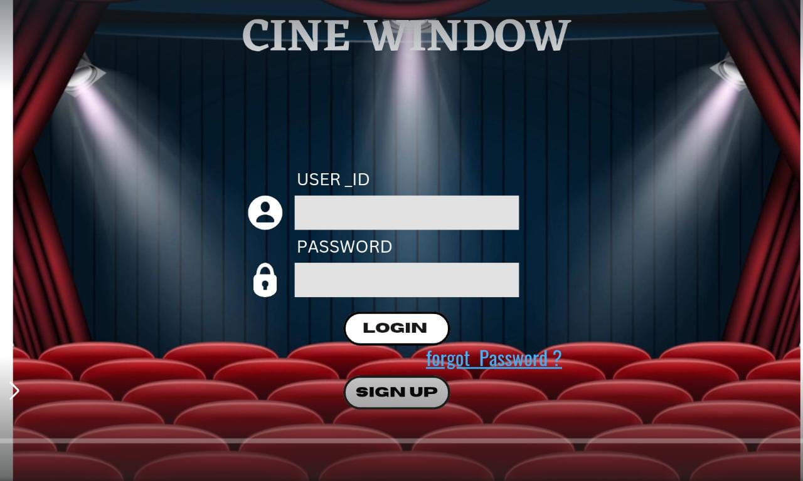
LAYOUT OF CUSTOMERS
1. LOGIN:

Slide 21
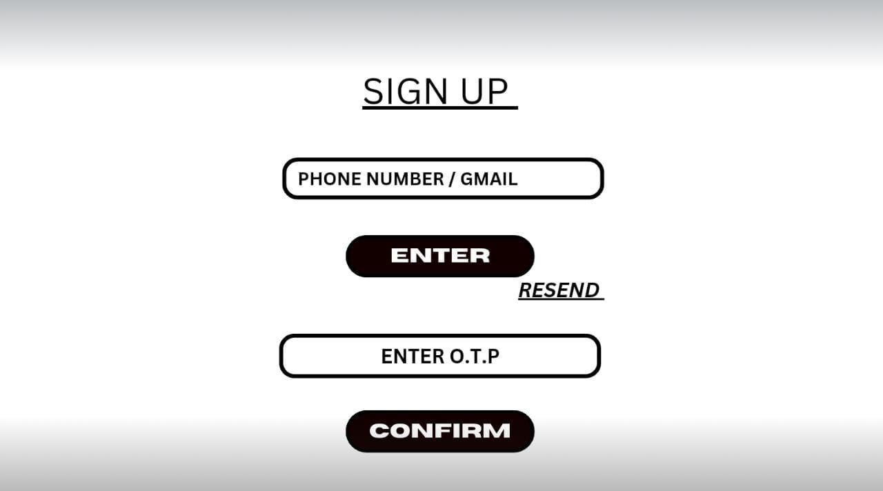
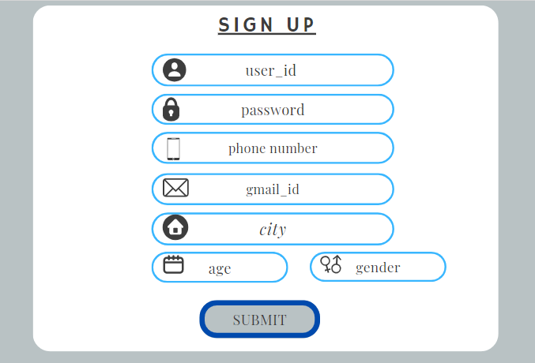
2. SIGN-UPS:

Slide 22
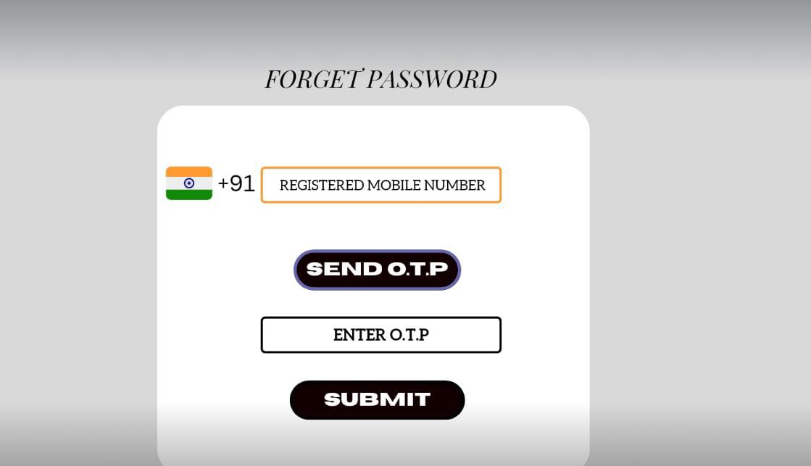
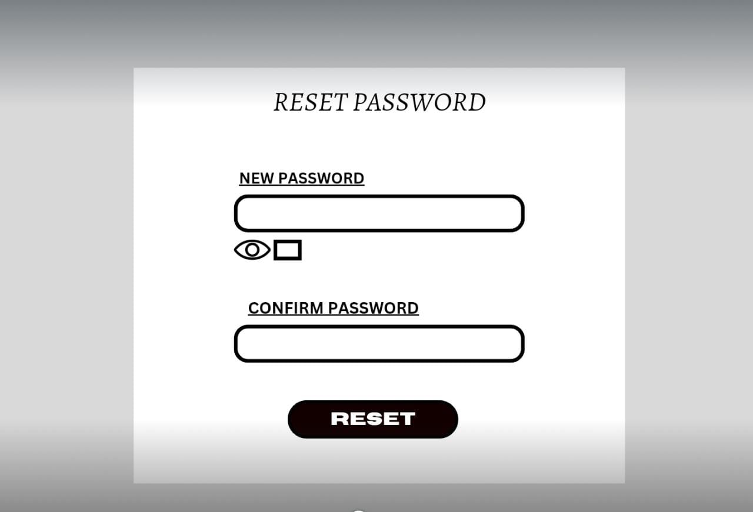
3. FORGET PASSWORD:

Slide 23
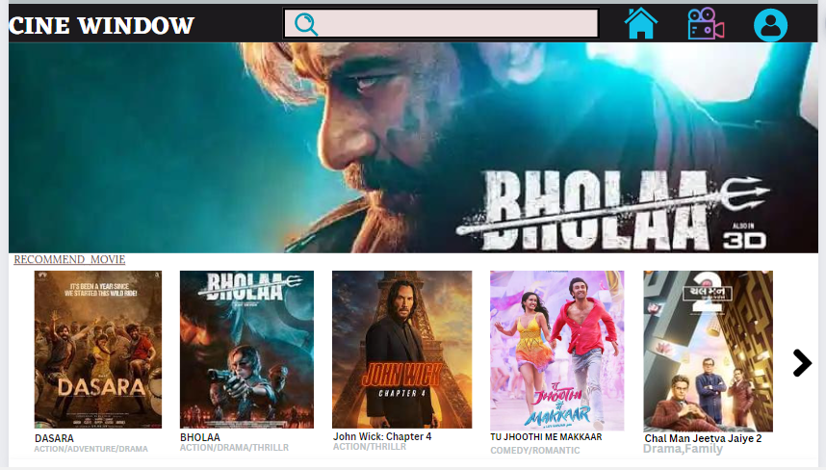
4. HOME PAGE:

Slide 24
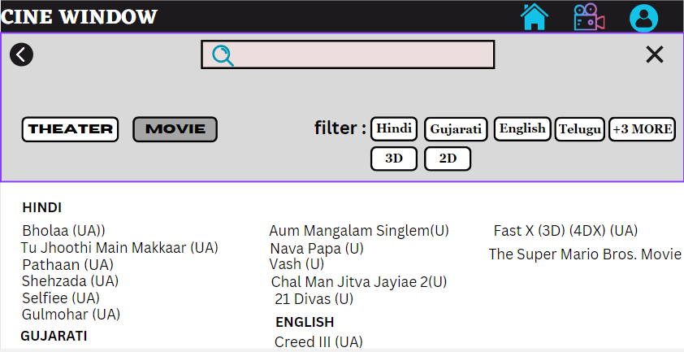
5. SEARCH:

Slide 25
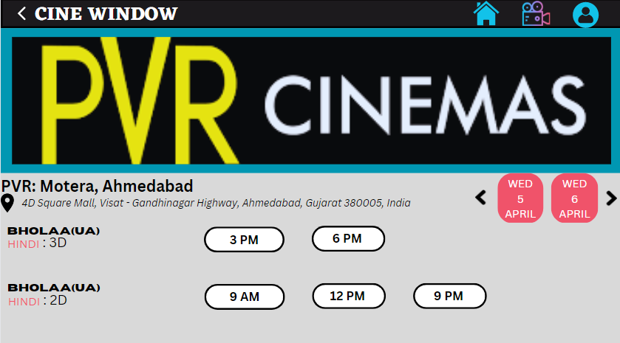
6. THEATRE SELECTION:

Slide 26
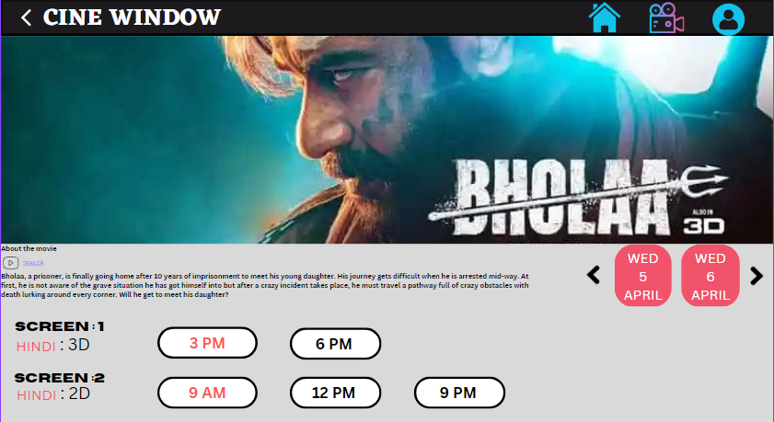
7. MOVIE PAGE:

Slide 27
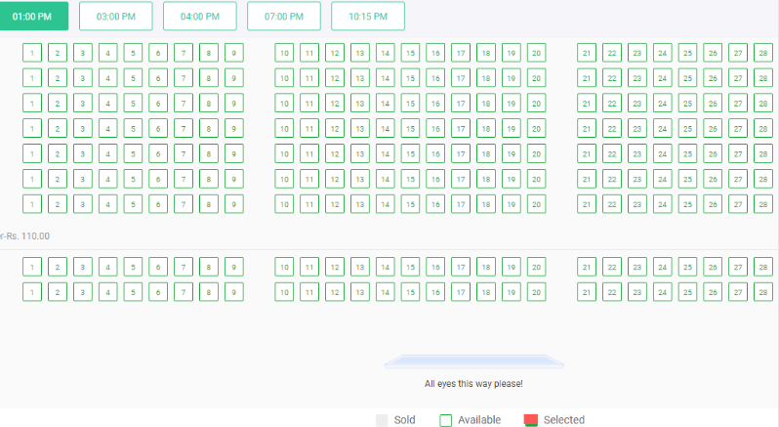
8. SEAT SELECTION:

Slide 28
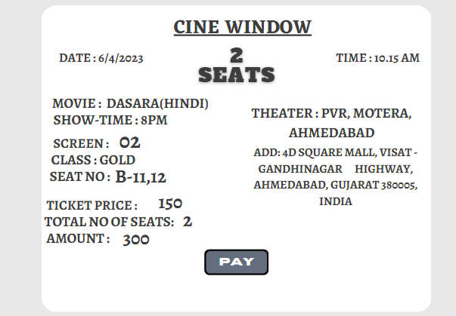
9. INVOICE:

Slide 29
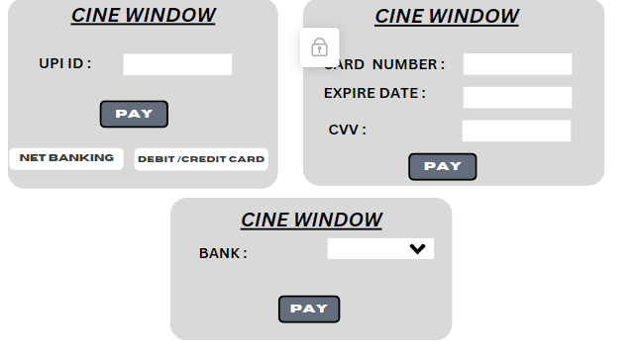
10. PAYMENT OPTION:

Slide 30
LAYOUT OF THEATRE OWNER:
1. LOGIN:

Slide 31
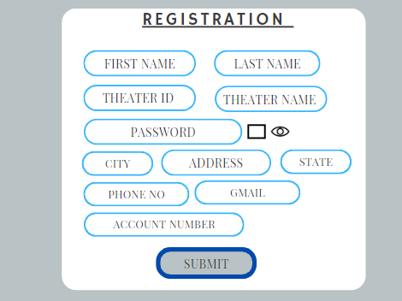
2.THEATER REGISTATION:

Slide 32
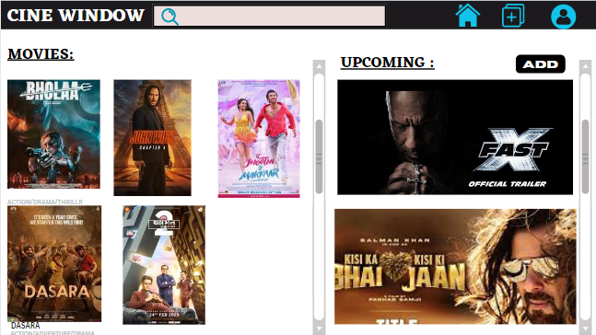
3. HOME PAGE:

Slide 33
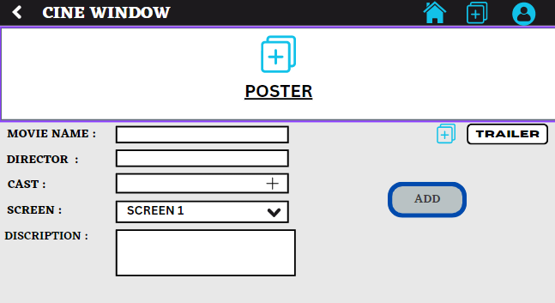
4. ADD MOVIE:

Slide 34
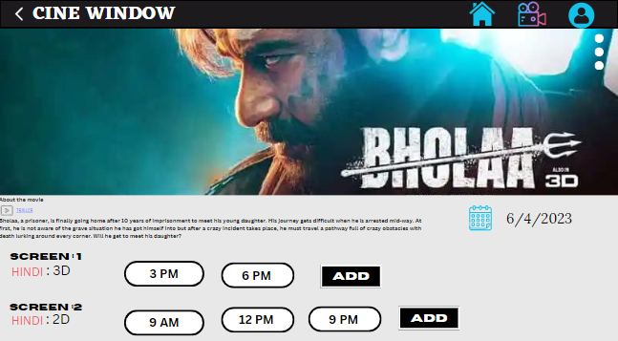
5. ADD SHOW:

Slide 35
LAYOUT OF ADMIN:
1. LOGIN:

Slide 36
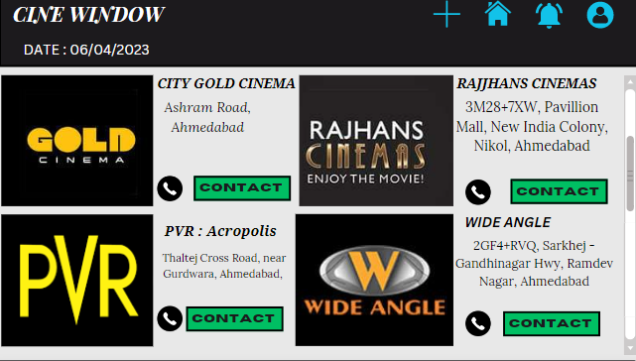
2. HOME PAGE:

Slide 37
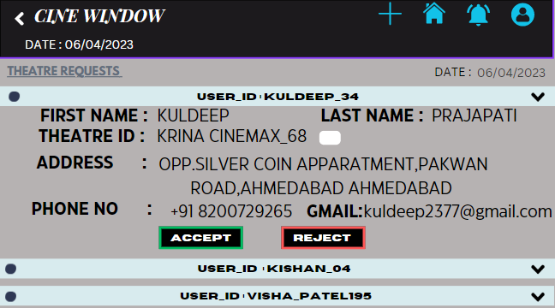
3. THEATRE REQUESTS:

Slide 38
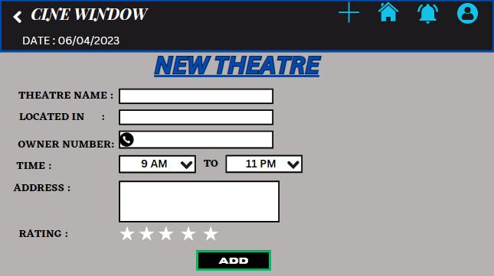
4. ADD THEATRE:

Slide 39
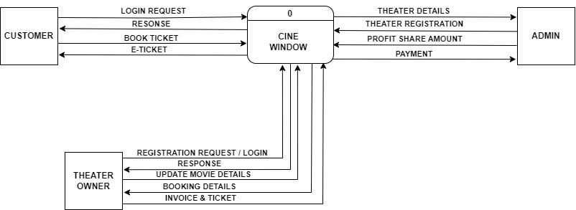
DATA FLOW DIAGRAM
LEVEL 0:

Slide 40
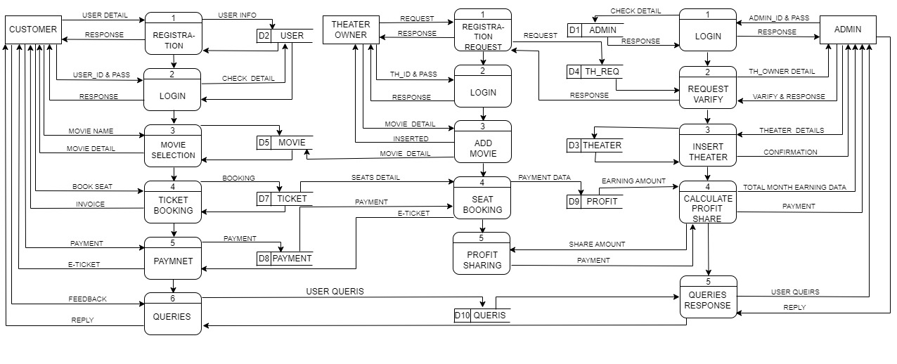
LEVEL 1:

Slide 41
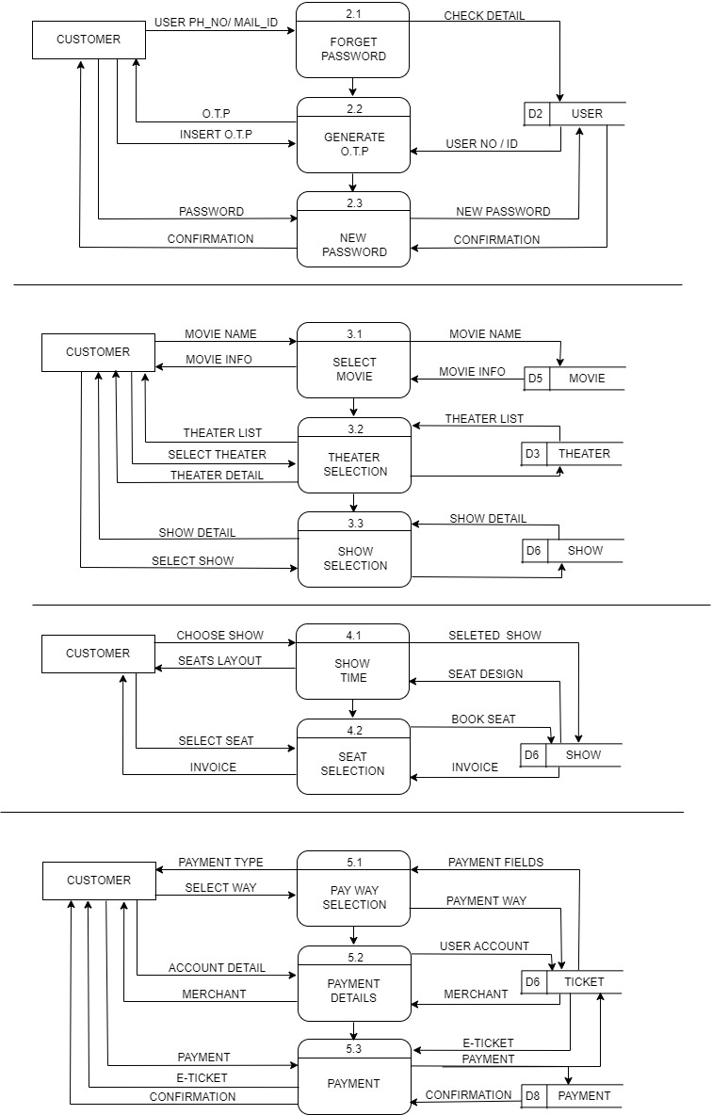
USER LEVEL 2:

Slide 42
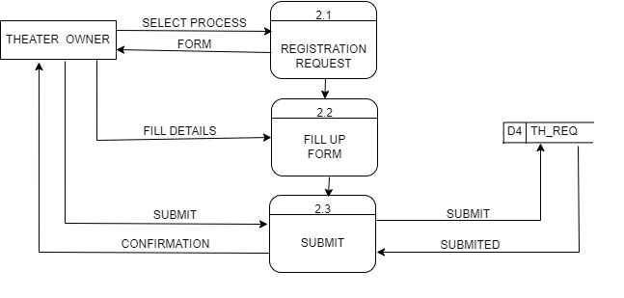

THEATRE OWNER LEVEL 2:

Slide 43
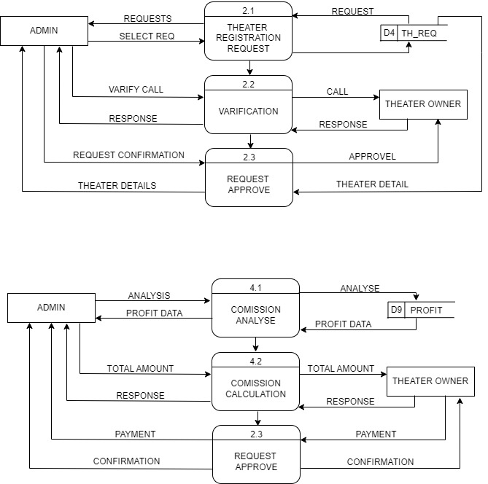
ADMIN OWNER LEVEL 2:

Slide 44
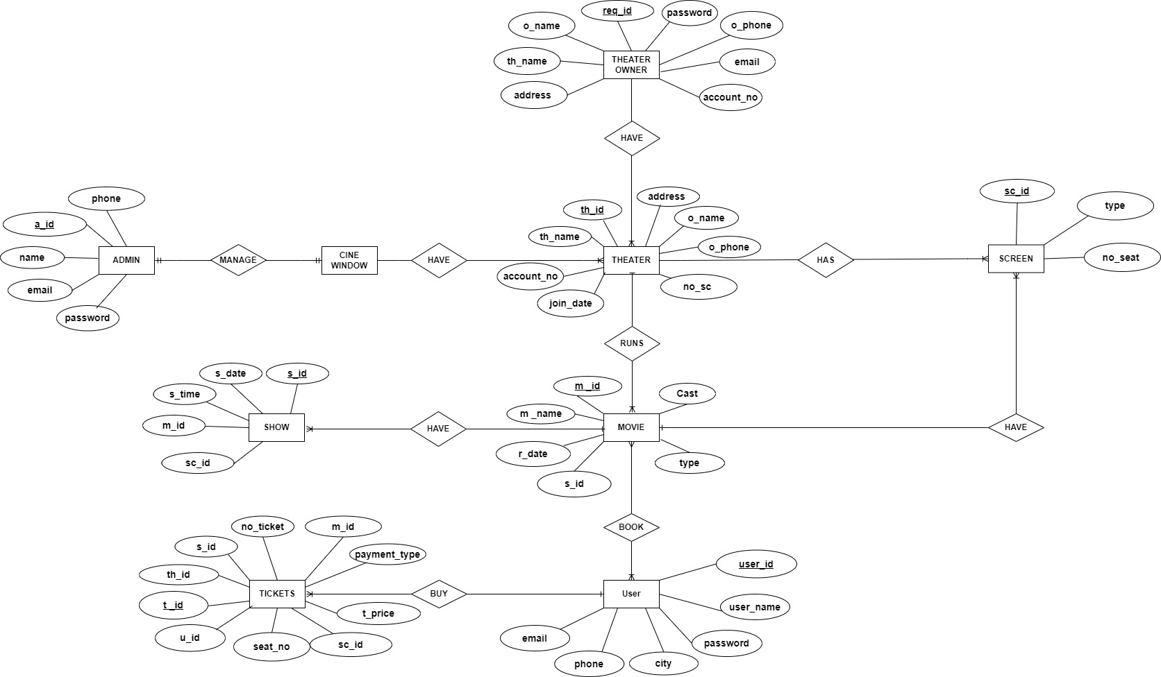
E-R DIAGRAM

Slide 45
Data Directory
Table name: ADMIN
Description: This table will store Admin’s information
FIELD NAME | DATA TYPE | SIZE | CONSTRAINT
a_id | INTEGER | 4 | PRIMARY KEY
password | VARCHAR | 30 | NOT NULL
name | VARCHAR | 15 | NOT NULL
phone | VARCHAR | 15 | NOT NULL
email | VARCHAR | 20 | NOT NULL

Slide 46
Table name: USER
Description: This table will store User’s information
FIELD NAME | DATA TYPE | SIZE | CONSTRAINT
u_id | INTEGER | 4 | PRIMARY KEY
u_name | VARCHAR | 18 | NOT NULL
password | VARCHAR | 30 | NOT NULL
phone | VARCHAR | 15 | NOT NULL
email | VARCHAR | 20 | NOT NULL
city | VARCHAR | 35 | NOT NULL

Slide 47
Table name: TH_REQ
Description: This table will store Th_req’s information
FIELD NAME | DATA TYPE | SIZE | CONSTRAINT
req_id | INTEGER | 4 | PRIMARY KEY
o_name | VARCHAR | 18 | NOT NULL
th_name | VARCHAR | 10 | NOT NULL
password | VARCHAR | 30 | NOT NULL
address | VARCHAR | 35 | NOT NULL
o_phone | VARCHAR | 15 | NOT NULL
email | VARCHAR | 20 | NOT NULL
account_no | VARCHAR | 20 | NOT NULL

Slide 48
Table name: THEATRE
Description: This table will store Theatre’s information
FIELD NAME | DATA TYPE | SIZE | CONSTRAINT
th_id | INTEGER | 4 | PRIMARY KEY
th_name | VARCHAR | 10 | NOT NULL
address | VARCHAR | 35 | NOT NULL
o_name | VARCHAR | 18 | NOT NULL
o_phone | VARCHAR | 15 | NOT NULL
join_date | VARCHAR | 15 | NOT NULL
no_sc | VARCHAR | 2 | NOT NULL
account_no | VARCHAR | 20 | NOT NULL

Slide 49
Table name: MOVIE
Description: This table will store Movie’s information
FIELD NAME | DATA TYPE | SIZE | CONSTRAINT
m_id | INTEGER | 4 | PRIMARY KEY
m_name | VARCHAR | 10 | NOT NULL
s_id | INTEGER | 4 | FOREIGN KEY
cast | VARCHAR | 50 | NOT NULL
r_date | VARCHAR | 20 | NOT NULL
type | VARCHAR | 7 | NOT NULL

Slide 50
Table name: TICKET
Description: This table will store Ticket’s information
FIELD NAME | DATA TYPE | SIZE | CONSTRAINT
t_id | INTEGER | 4 | PRIMARY KEY
th_id | INTEGER | 4 | FOREIGN KEY
m_id | INTEGER | 4 | FOREIGN KEY
s_id | INTEGER | 4 | FOREIGN KEY
u_id | INTEGER | 4 | FOREIGN KEY
sc_id | INTEGER | 4 | FOREIGN KEY
no_ticket | INTEGER | 4 | NOT NULL
seat_no | VARCHAR | 4 | NOT NULL
payment_type | VARCHAR | 5 | NOT NULL
t_price | VARCHAR | 4 | NOT NULL

Slide 51
Table name: SCREEN
Description: This table will store Screen’s information
FIELD NAME | DATA TYPE | SIZE | CONSTRAINT
sc_id | INTEGER | 4 | PRIMARY KEY
no_seat | INTEGER | 2 | NOT NULL
type | VARCHAR | 7 | NOT NULL

Slide 52
Table name: SHOW
Description: This table will store Show’s information
FIELD NAME | DATA TYPE | SIZE | CONSTRAINT
s_id | INTEGER | 4 | PRIMARY KEY
s_date | VARCHAR | 10 | NOT NULL
s_time | VARCHAR | 10 | NOT NULL
m_Id | INTEGER | 4 | FOREIGN KEY
sc_id | INTEGER | 4 | FOREIGN KEY

Slide 53
Table name: QUERY
Description: This table will store Query’s information
FIELD NAME | DATA TYPE | SIZE | CONSTRAINT
q_id | INTEGER | 4 | PRIMARY KEY
u_id | INTEGER | 4 | FOREIGN KEY
q_date | VARCHAR | 10 | NOT NULL
queries | VARCHAR | 10 | NOT NULL

Slide 54
Table name: PAYMENT
Description: This table will store Payment’s information
FIELD NAME | DATA TYPE | SIZE | CONSTRAINT
pay_id | INTEGER | 4 | PRIMARY KEY
u_id | INTEGER | 4 | FOREIGN KEY
t_id | INTEGER | 4 | FOREIGN KEY
total_amount | VARCHAR | 4 | NOT NULL
time | VARCHAR | 10 | NOT NULL

Slide 55
Table name: PROFIT
Description: This table will store Profit’s information
FIELD NAME | DATA TYPE | SIZE | CONSTRAINT
th_id | INTEGER | 4 | PRIMARY KEY
date | VARCHAR | 10 | NOT NULL
total_amount | VARCHAR | 4 | NOT NULL
p_status | VARCHAR | 4 | NOT NULL
payment_id | VARCHAR | 20 | NOT NULL

Slide 56
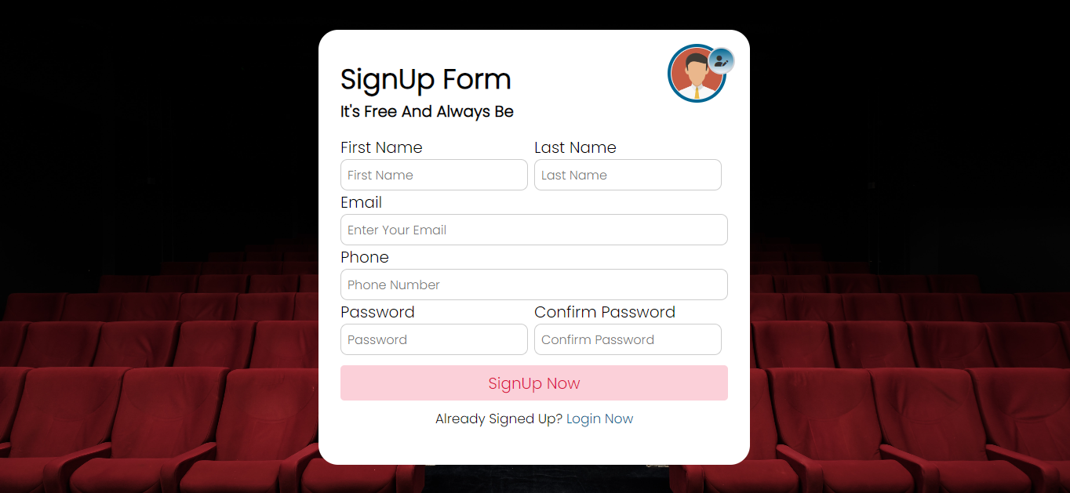
REGISTRATION AND LOGIN FORM WITH CODING
1 SYSTEM DESIGNS OF AUTHENTICATION: SIGNUP & LOGIN FORM (SCREEN LAYOUT)
Sign-up

Slide 57
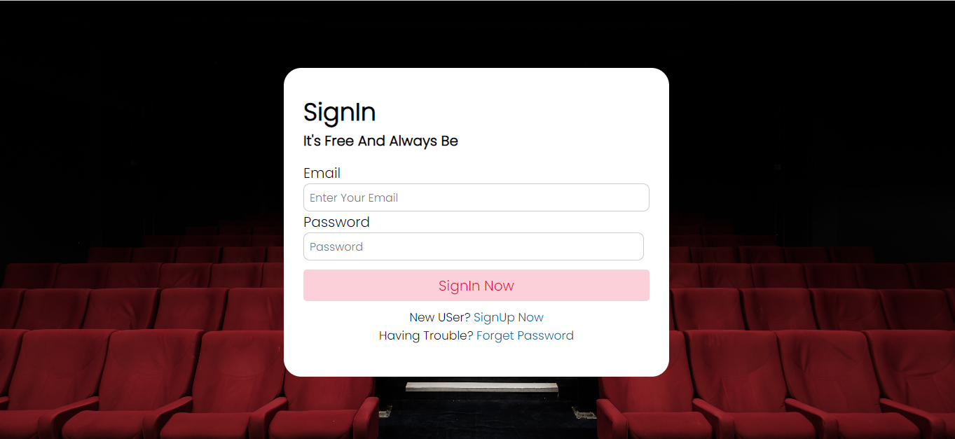
Log-in

Slide 58
2.SYSTEM DESIGNS OF AUTHENTICATION: SIGNUP & LOGIN FORM (CODING)
Log in
<!DOCTYPE html>
<html lang="en">
<head>
<meta charset="UTF-8">
<meta http-equiv="X-UA-Compatible" content="IE=edge">
<meta name="viewport" content="width=device-width, initial-scale=1.0">
<!-- <link rel="stylesheet" href="../css/style.css"> -->
<link rel="icon" type="image/x-icon" href="../static_imgs/fav.png">
<link rel="stylesheet" href="../css/styles.css">
<title>CineWindows | Login</title>
</head>
<body>
<div class="form">
<h2>SignIn</h2>
<p>It's Free And Always Be</p>
<form action="">
<div class="error-text">

Slide 59
Error
</div>
<div class="input">
<label>Email</label>
<input type="email" name="email" placeholder="Enter Your Email" required>
</div>
<div class="grid-details">
<div class="input">
<label>Password</label>
<input type="password" name="pass" placeholder="Password" required>
</div>
</div>
<div class="submit" >
<input type="submit" value="SignIn Now" class="button">
</div>
</form> <div class="link">
New USer?
<a href="register.php">SignUp Now</a><br>
Having Trouble?
<a href="forget_password/fp_frontend.php">Forget Password</a>
</div>
</div>
<script src="../js/log_5.js"></script>
</body>
</html>

Slide 60
Sign-up
<?php
session_start();
include_once 'db.php';
$fname = $_POST['fname'];
$lname = $_POST['lname'];
$email = $_POST['email'];
$phone = $_POST['phone'];
$password = md5($_POST['pass']);
$cpassword = md5($_POST['cpass']);
//chacking fields are not empty
if(!empty($fname) && !empty($lname) && !empty($email) && !empty($phone) && !empty($password) && !empty($cpassword) )
{ //if email is valid
if(filter_var($email,FILTER_VALIDATE_EMAIL))
{ //checking if email already present
$pra = "SELECT email FROM user WHERE email = '{$email}'";
$sql = mysqli_query($conn,$pra);
if(mysqli_num_rows($sql)>0)
{
echo "$email ~ Already Exists";
}

Slide 61
else
{
$prat = "SELECT phone FROM user WHERE phone = '{$phone}'";
$ph = mysqli_query($conn,$prat);
if(mysqli_num_rows($ph)>0)
{
echo "$phone ~ Already Exists";
}
else
{
if($password == $cpassword )
{
//let us check user upload file or not
if(isset($_FILES['image']))
{
$img_name = $_FILES['image']['name'];
$img_typ = $_FILES['image']['type'];
$tmp_name = $_FILES['image']['tmp_name'];
$img_explode = explode('.',$img_name);
$img_extension = end($img_explode);
$extensions = ['png','jpg','jpeg'];
if(in_array($img_extension,$extensions) === true)
{
$time = time();
$newimagename = $time . $img_name;
$folder = '../img/' .$newimagename;
if(move_uploaded_file($tmp_name, $folder))
{
$random_id = rand(100,1000);//creating a user unique id
$otp = mt_rand(1111,9999);//creating otp 4 digit

Slide 62
$inn = "INSERT INTO user (user_id,fname,lname,email,phone,password,image,otp) VALUES ({$random_id},'{$fname}','{$lname}','{$email}','{$phone}','{$password}','{$folder}','{$otp}')";
$sql2 = mysqli_query($conn,$inn);
if($sql2)
{
// $pratham = ;
$sql3 = mysqli_query($conn, "SELECT * FROM user WHERE email = '{$email}'");
if(mysqli_num_rows($sql3)>0)
{
$row = mysqli_fetch_assoc($sql3);
$_SESSION['unique_id'] = $row['user_id'];
$_SESSION['email'] = $row['email'];
$_SESSION['otp'] = $row['otp'];
//email session
if($otp)
{
$headers = "From : CineWindows";
$receiver = $email;
$subject = "CineWindows🎥 OTP Registration : ".$otp;
$body = "ThankYou For Choosing Us (:\nDon't Share Your OTP With AnyOne\nName : "." $fname $lname \nEmail : "." $email\n"."OTP : " . $otp."\nWe Are Happy To Have You\nMade With Love😊💕❤️";
$sender = "From : cinewindows121@gmail.com";

Slide 63
if(mail($receiver,$subject,$body,$sender,$headers))
{
echo "Success";
}
else
{
echo "Problem";
}
}
//email end
}
else{
echo "Somthing Went Wrong";
}
}
else
{
echo "something Went Wrong";
}
}
}
else
{
echo "Image Extension Does Not Matched";
}

Slide 64
}
else
{
echo "Please Select An Profile Image";
}
}
else
{
echo "Password Is Not Matching!!";
}
}
}
}
else
{
echo "$email ~ This is Not A Valid Email";
}
}
else
{
echo "All Fields Are required";
}
?>

Slide 65
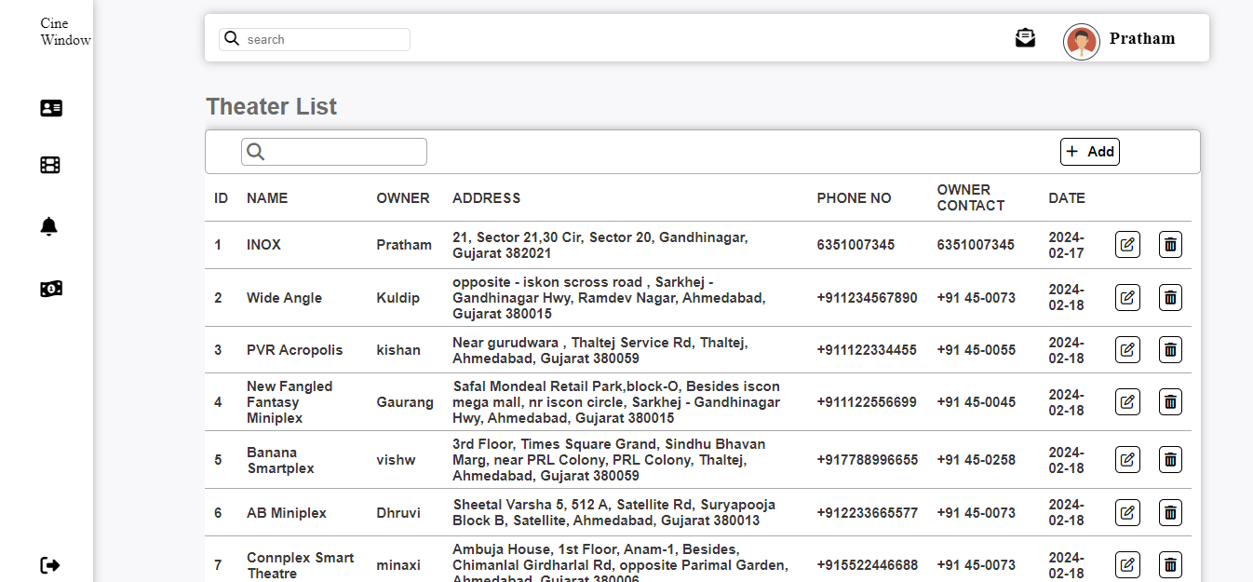
3. SYSTEM ADMINISTRATION FORM (ADD, UPDATE, DELETE)
Admin page

Slide 66
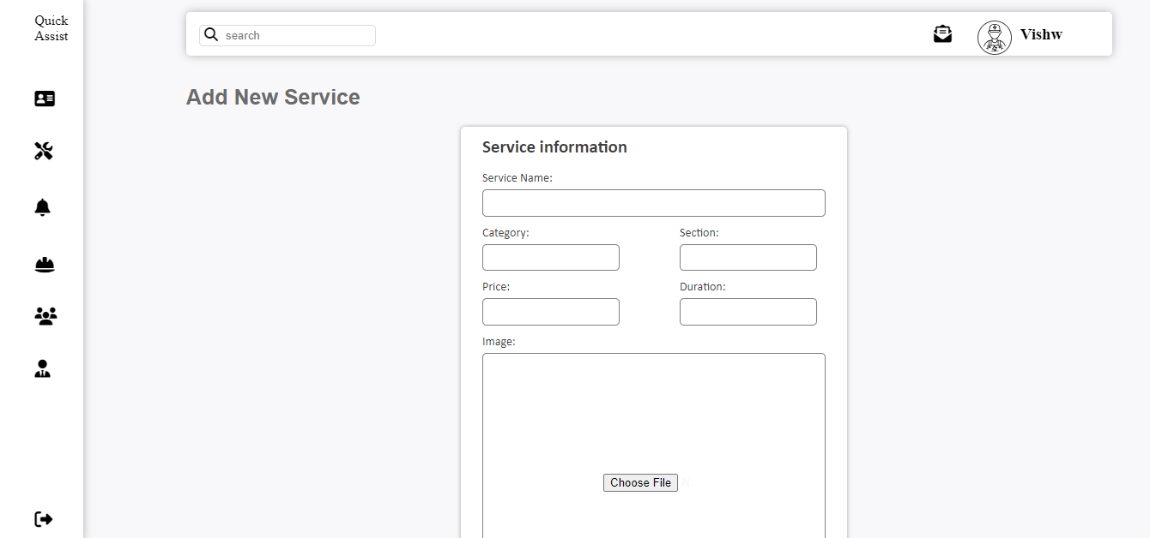
Admin theater Service Add page

Slide 67
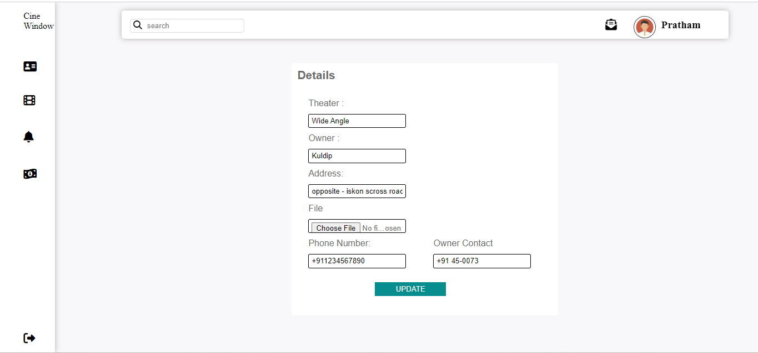
Admin theater list Update page

Slide 68
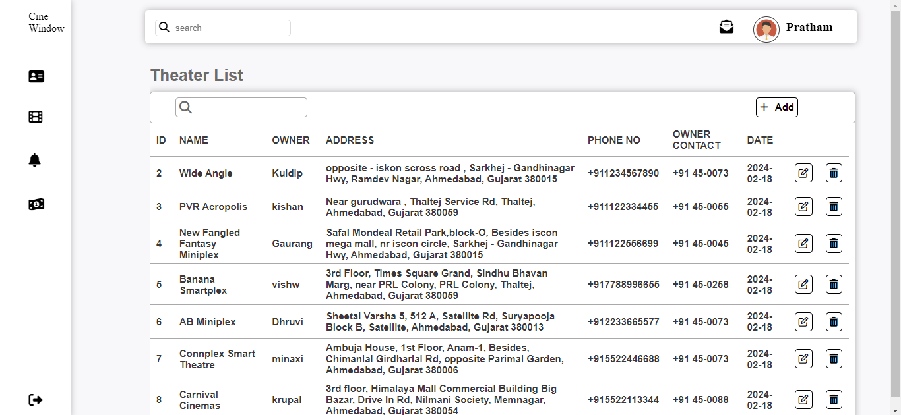
Admin theater Service Delete page

Slide 69
Insert
?php require 'cwheader.php' ?>
<?php
if (isset($_GET['id'])) {
$th_id = $_GET['id'];
$sqlDelete = "DELETE FROM cinema WHERE cinema_id='$th_id'";
if (mysqli_query($conn, $sqlDelete)) {
header("location:theater.php");
} else {
header("location:theater.php");
}}
?>
<?php
if (isset($_POST['insert'])) {
$th_name = $_POST['th_name'];
$own_name = $_POST['own_name'];
$th_address = $_POST['th_address'];
$th_phone = $_POST['th_phone'];
$own_phone = $_POST['own_phone'];
$th_pass = $_POST['th_pass'];

Slide 70
//inserting image
$img_name = $_FILES['file']['name'];
$img_typ = $_FILES['file']['type'];
$tmp_name = $_FILES['file']['tmp_name'];
$img_explode = explode('.', $img_name);
$img_extension = end($img_explode);
$extensions = ['png', 'jpg', 'jpeg'];
if (in_array($img_extension, $extensions) === true) {
$time = time();
$newimagename = $time . $img_name;
$folder = '../img/' . $newimagename;
move_uploaded_file($tmp_name, $folder);
}
$th_img = $_POST['th_img'];
$sqlinsert = "INSERT INTO cinema
(cinema_name,own_name,cinema_location,cinema_phone,own_phone,movie_fk) VALUES ('$th_name','$own_name','$th_address','$th_phone','$own_phone','$th_pass')";
if (mysqli_query($conn, $sqlinsert)) {
header("Location: theater.php");
} else {
header("Location: threq.php");
}
}

Slide 71
Update
?php require 'cwheader.php'; ?>
<!DOCTYPE html>
<html lang="en">
<head>
<meta charset="UTF-8">
<meta name="viewport" content="width=device-width, initial-scale=1.0">
<title>Update Theater</title>
<link rel="stylesheet" href="cw.css">
<script src="https://kit.fontawesome.com/61163db8e0.js" crossorigin="anonymous"></script>
</head>
<body>
<main>
<div id="updatetheater">
<h5>Details </h5>
<?php
if (isset($_GET['id'])) {
$id = $_GET['id'];
$sqlupdate = "SELECT * FROM cinema WHERE cinema_id = $id";
$result = mysqli_query($conn, $sqlupdate);

Slide 72
if (!$result) {
die("query Failed" . mysqli_error());
} else {
while ($row = mysqli_fetch_assoc($result)) {
?>
<form method="post" action="thupdate.php?id_new=<?php echo $id; ?>" enctype="multipart/form-data">
<div class="show">
<lable>Theater :</lable>
<input type="text" value="<?php echo $row['cinema_name']; ?>" name="th_name"> </div>
<div class="show">
<lable>Owner :</lable>
<input type="text" value="<?php echo $row['own_name']; ?>" name="own_name">
</div>
<div class="show">
<lable>Address:</lable>
<input type="text" value="<?php echo $row['cinema_location']; ?>" name="th_address">
</div>

Slide 73
<?php
if (isset($_POST['thupdate'])) {
if (isset($_GET['id_new'])) {
$id_new = $_GET['id_new'];
}
$th_name = $_POST['th_name'];
$own_name = $_POST['own_name'];
$th_address = $_POST['th_address'];
$th_phone = $_POST['th_phone'];
$own_phone = $_POST['own_phone'];
//image insert
$img_name = $_FILES['file']['name'];
$img_typ = $_FILES['file']['type'];
$tmp_name = $_FILES['file']['tmp_name'];
$img_explode = explode('.', $img_name);
$img_extension = end($img_explode);
$extensions = ['png', 'jpg', 'jpeg','webp'];

Slide 74
if (in_array($img_extension, $extensions) === true) {
$time = time();
$newimagename = $time . $img_name;
$folder = '../img/' . $newimagename;
move_uploaded_file($tmp_name, $folder);
} $sql = "UPDATE cinema SET cinema_name='$th_name', own_name = '$own_name', cinema_location = '$th_address',cinema_phone = '$th_phone',own_phone = '$own_phone' ,cinema_img='$folder' WHERE cinema_id= '$id_new'";
if (mysqli_query($conn, $sql)) {
header("Location: theater.php");
} else {
header("Location: thupdate.php");
}
}
?>
</main>
</body> </html>

Slide 75
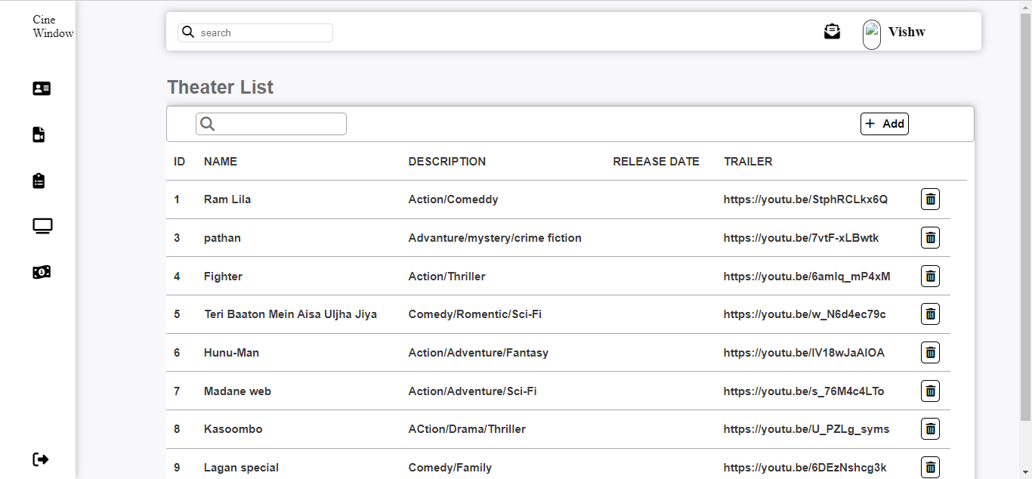
theater owner movie page

Slide 76
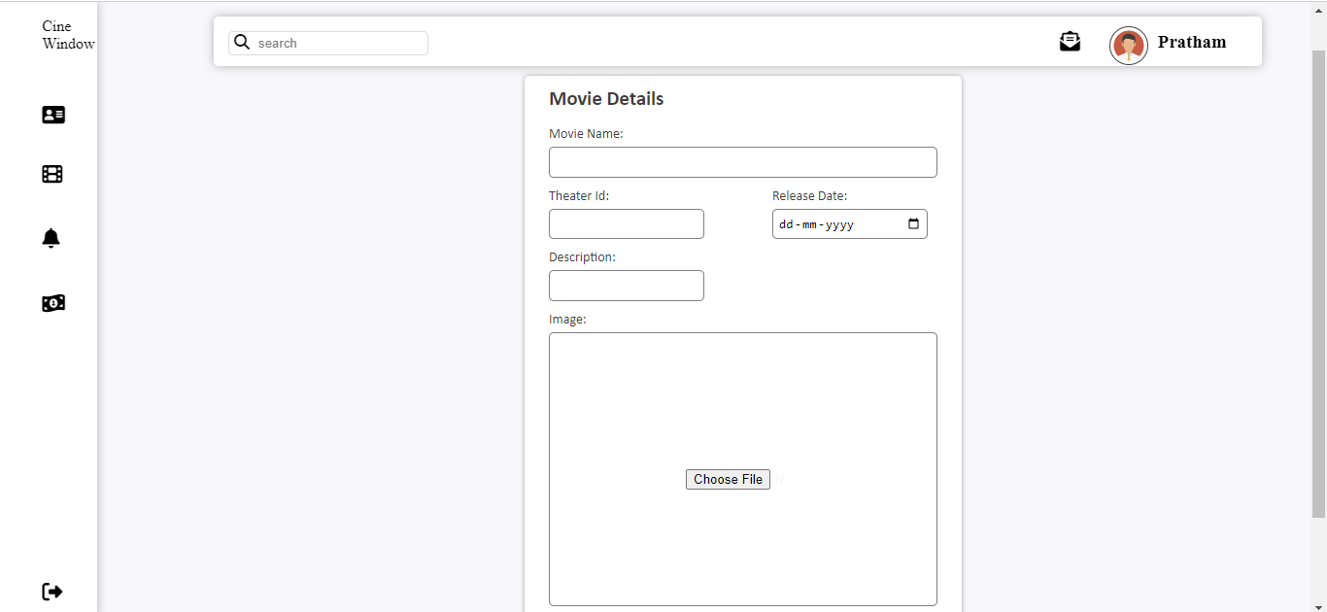
theater owner add movie page

Slide 77
theater owner delete movie page

Slide 78
<?php require'cwheader.php'?>
<?php
?>
<!DOCTYPE html>
<html lang="en">
<head>
<meta charset="UTF-8">
<meta name="viewport" content="width=device-width, initial-scale=1.0">
<script src="https://kit.fontawesome.com/61163db8e0.js" crossorigin="anonymous"></script>
<link rel="stylesheet" href="cw.css">
</head>
<body>
<main>
<div>
<div class="forms">
<div class="insertform">

Slide 79
<h5>Movie Details</h5>
<form action="movieinsert.php" method="post">
<div class="input">
<label>Movie Name:</label>
<input type="text" name="movie_name">
</div>
<div class="fieldinput">
<div class="input">
<label>Theater Id:</label>
<input type="text" name="th_id">
</div>
<div class="input">
<label>Release Date:</label>
<input type="date" name="r_date">
</div>
</div>

Slide 80
<div class="fieldinput">
<div class="input">
<label>Description:</label>
<input type="text" name="description">
</div>
</div>
<div class="decimbox">
<div class="input">
<label>Image:</label>
<input type="file" name="movie_img" id="img">
</div>
</div>
<button type="submit" name="insert" id="insertbtn">Add</button>
</form>
</div>
</div>
</div>
</main>
</body>
</html>

Slide 81
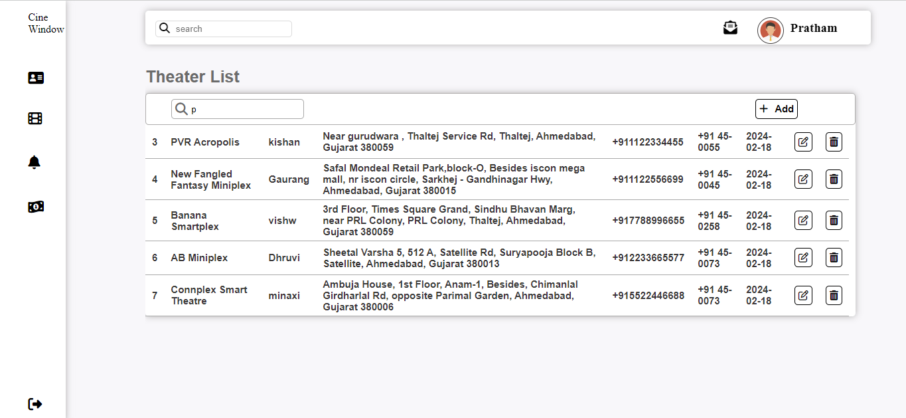
4.SYSTEM ADMINISTRATION FORM (SEARCHING)
Admin theater Service search bar

Slide 82
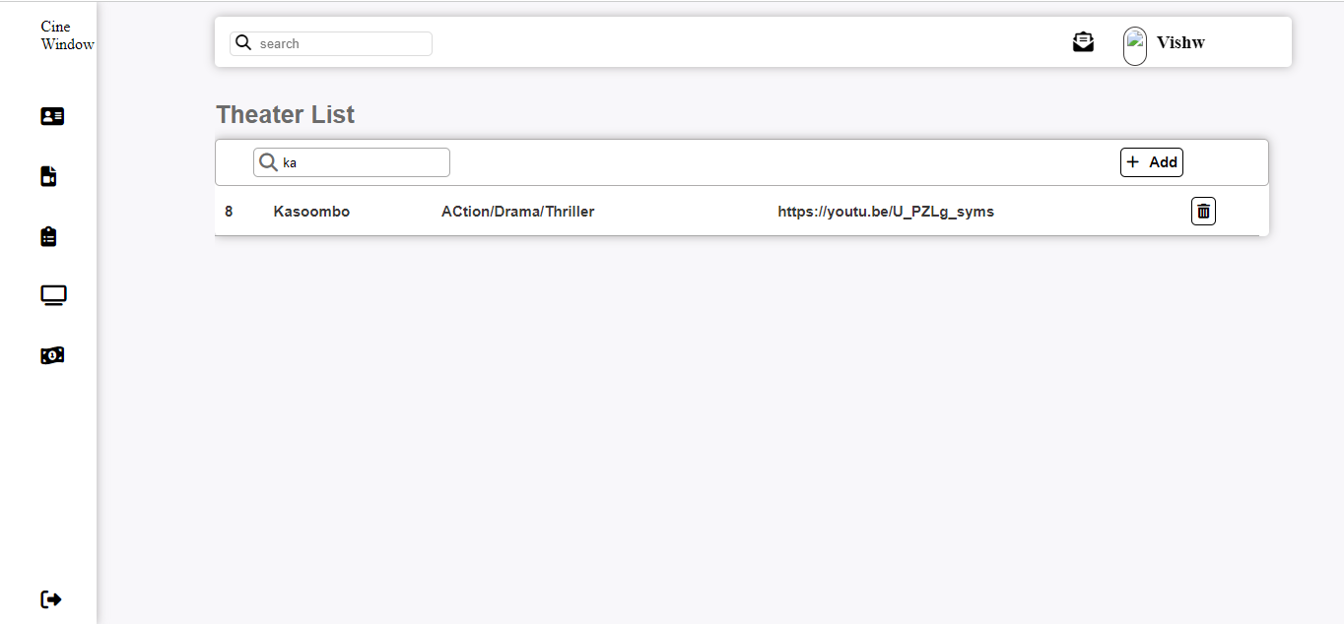
theater owner search bar

Slide 83
function search()
{
var input,filter,table,tr,td,i,textvalue;
input = document.getElementById("search");
filter = input.value.toUpperCase();
table = document.getElementById("table");
tr = table.getElementsByTagName("tr");
for(i=0;i<tr.length;i++)
{
td = tr[i].getElementsByTagName("td")[3];
if(td)
{
textvalue = td.textContent;
if(textvalue.toUpperCase().indexOf(filter) > -1)
{
tr[i].style.display="";
}
else
{
tr[i].style.display="none";
}
}
}
}

Slide 84
function thsearch()
{
var input,filter,table,tr,td,i,textvalue;
input = document.getElementById("search");
filter = input.value.toUpperCase();
table = document.getElementById("table");
tr = table.getElementsByTagName("tr");
for(i=0;i<tr.length;i++)
{
td = tr[i].getElementsByTagName("td")[1];
if(td)
{
textvalue = td.textContent;
if(textvalue.toUpperCase().indexOf(filter) > -1)
{
tr[i].style.display="";
}
else
{
tr[i].style.display="none";
}
}
}
}

Slide 85
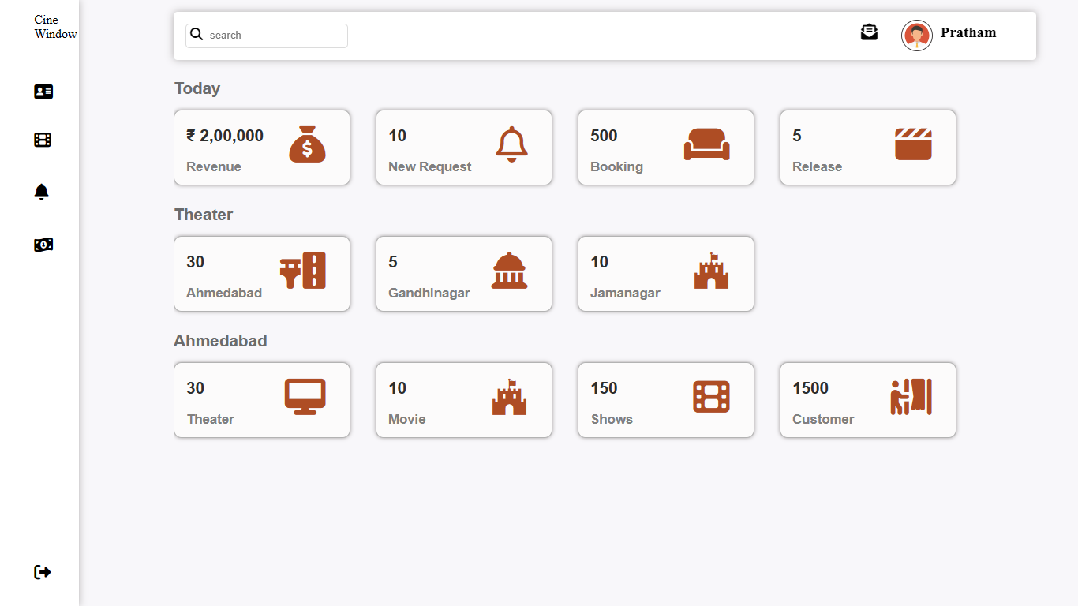
5. SYSTEM REPORT GENERATION
Report

Slide 86
6. SYSTEM VALIDATIONS: VALIDATIONS FOR VARIOUS LEVEL

Slide 87
if (empty($unique)){
header("location: login.php");
}
AND
//username variables
$unique_id = $_GET['user_id'];
if (empty($unique_id)){
header("location: index.php");
}

Slide 88
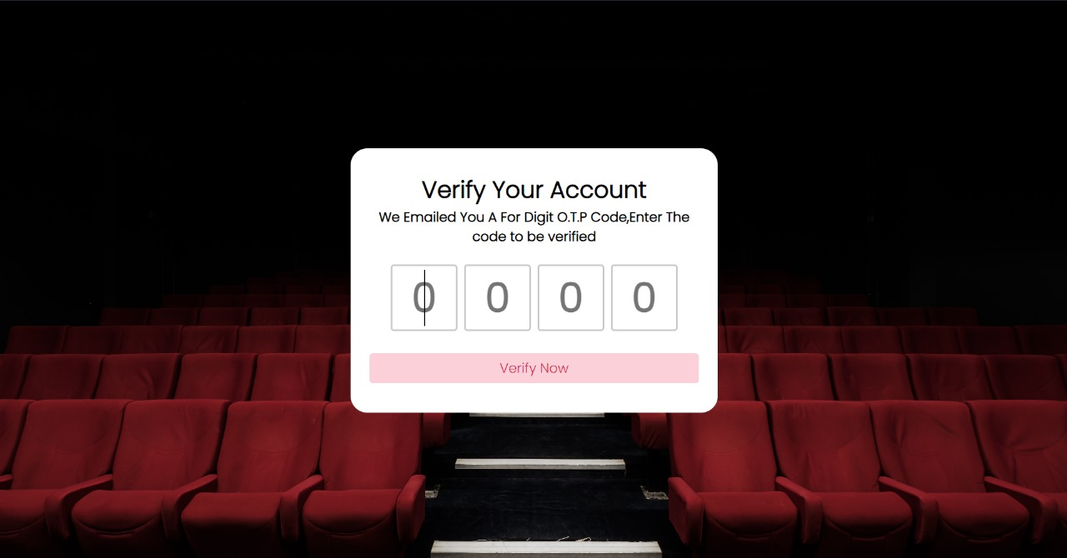
7. MISC. FEATURES (OTP)

Slide 89
<?php
include_once 'db.php';
session_start();
$otp1 = $_POST['otp1'];
$otp2 = $_POST['otp2'];
$otp3 = $_POST['otp3'];
$otp4 = $_POST['otp4'];
$unique_id = $_SESSION['unique_id'];
$session_otp = $_SESSION['otp'];
$otp = $otp1.$otp2.$otp3.$otp4;
if(!empty($otp))
{ //matching otp
if($otp == $session_otp)
{
$op = "SELECT * FROM user WHERE user_id = '{$unique_id}' AND otp = '{$otp}' ";
$sql = mysqli_query ($conn,$op);
//if matched
if(mysqli_num_rows($sql)>0)
{
$null_otp = 0;
$update = "UPDATE user SET verify = '1' , otp = '{$null_otp}' WHERE user_id = '{$unique_id}' ";
$sql2 = mysqli_query($conn,$update);

Slide 90
if($sql2)
{
$row = mysqli_fetch_assoc($sql);
if($row)
{
$receiver = $row['email'];
$subject = "CineWindows🎥 ,Account Verified!!";
$body = "ThankYou For Choosing Us, \nWelcome To Cinewindow's Family\nMade With Love❤️💕😊";
$sender = "From : cinewindows121@gmail.com";
if(mail($receiver,$subject,$body,$sender))
{
$unique_id = $_SESSION['unique_id'];
$_SESSION['unique_id'] = $row['user_id'];
$_SESSION['verification_status'] = $row['verify'];
echo "Success";
}
else
{
echo "No Internet Connection!!😔";
}
} }} } else {
echo "O.T.P Not Matched";
}
}
else{
echo "Enter Otp";
}
?>

Slide 91
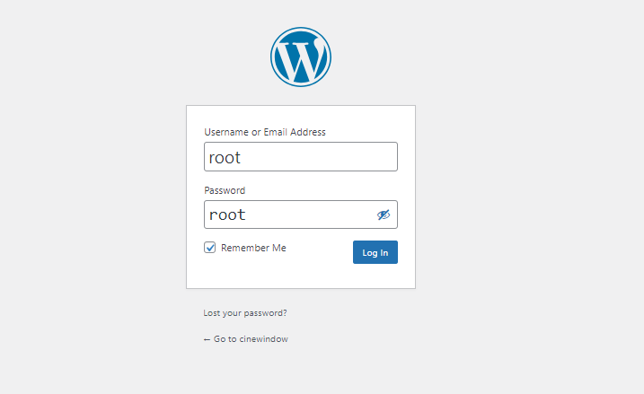
WORDPRESS
1 LOGIN

Slide 92
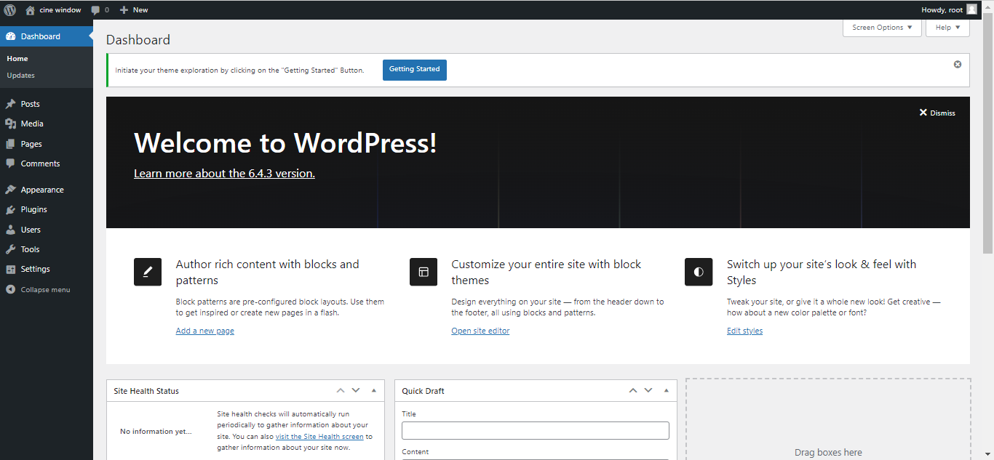
2 DASHBOARDS

Slide 93
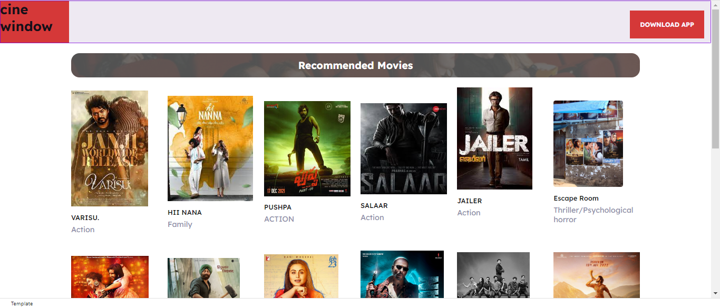
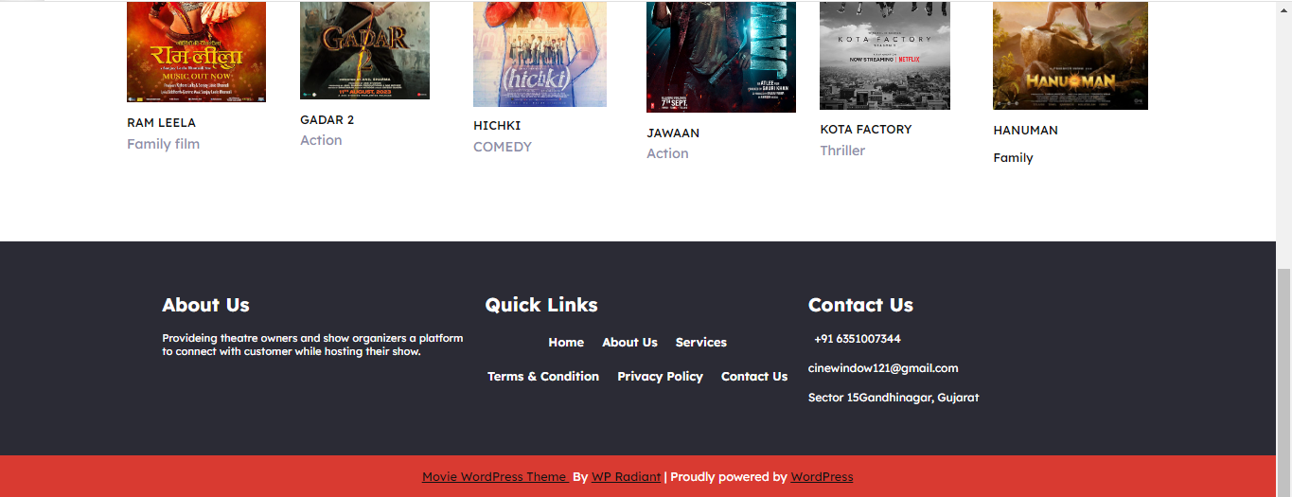
3. HOME PAGE

